Slide 1
FORTUNE 2.0
Chong In Lei

Slide 2
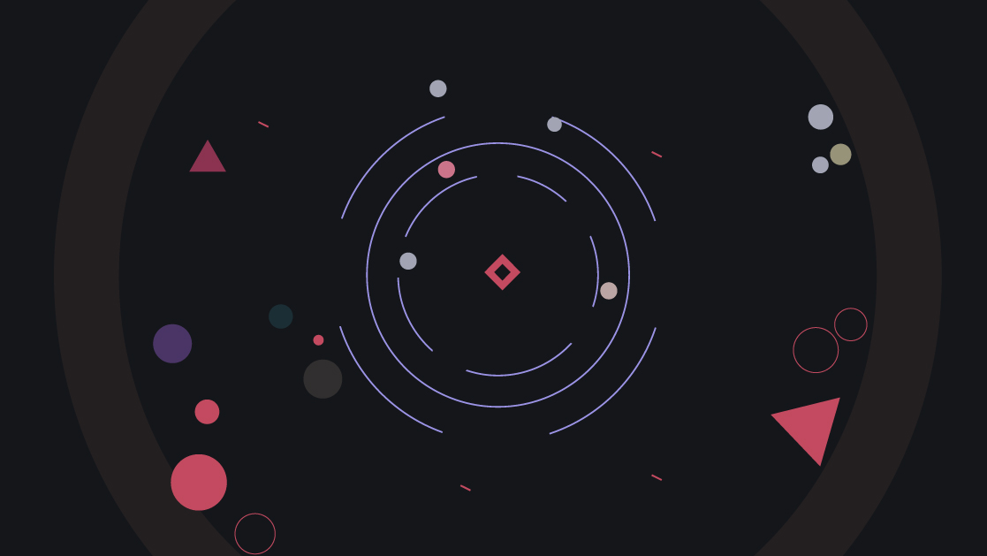
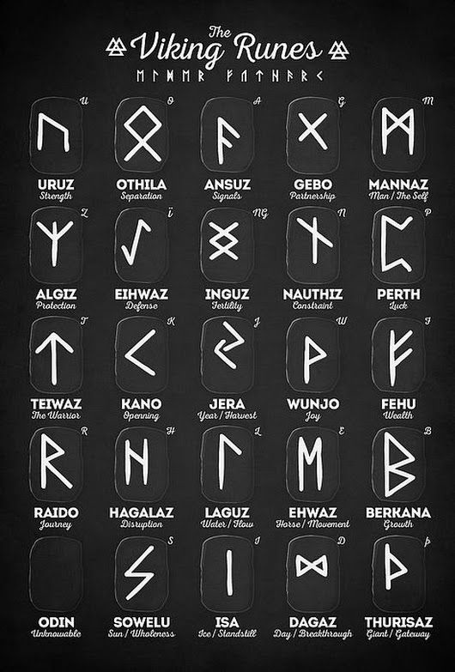
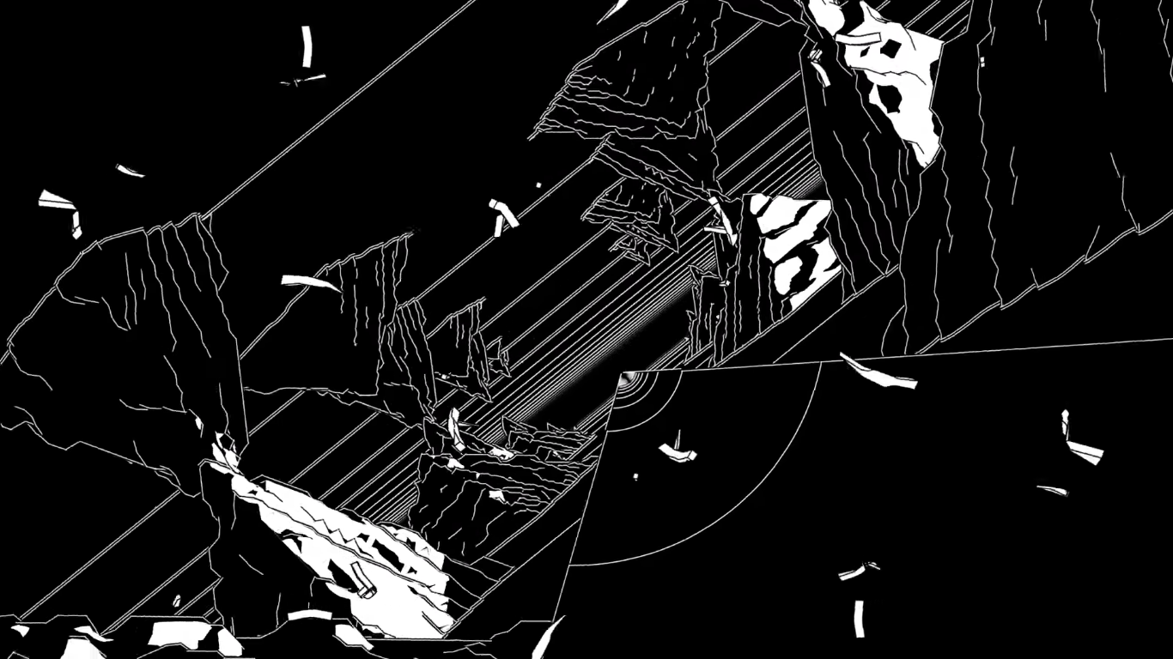
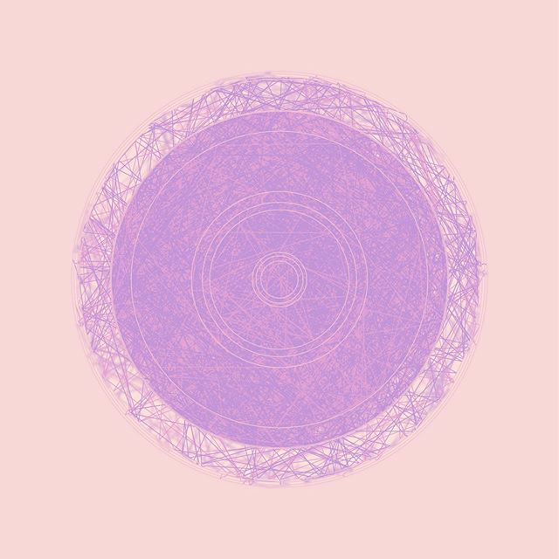
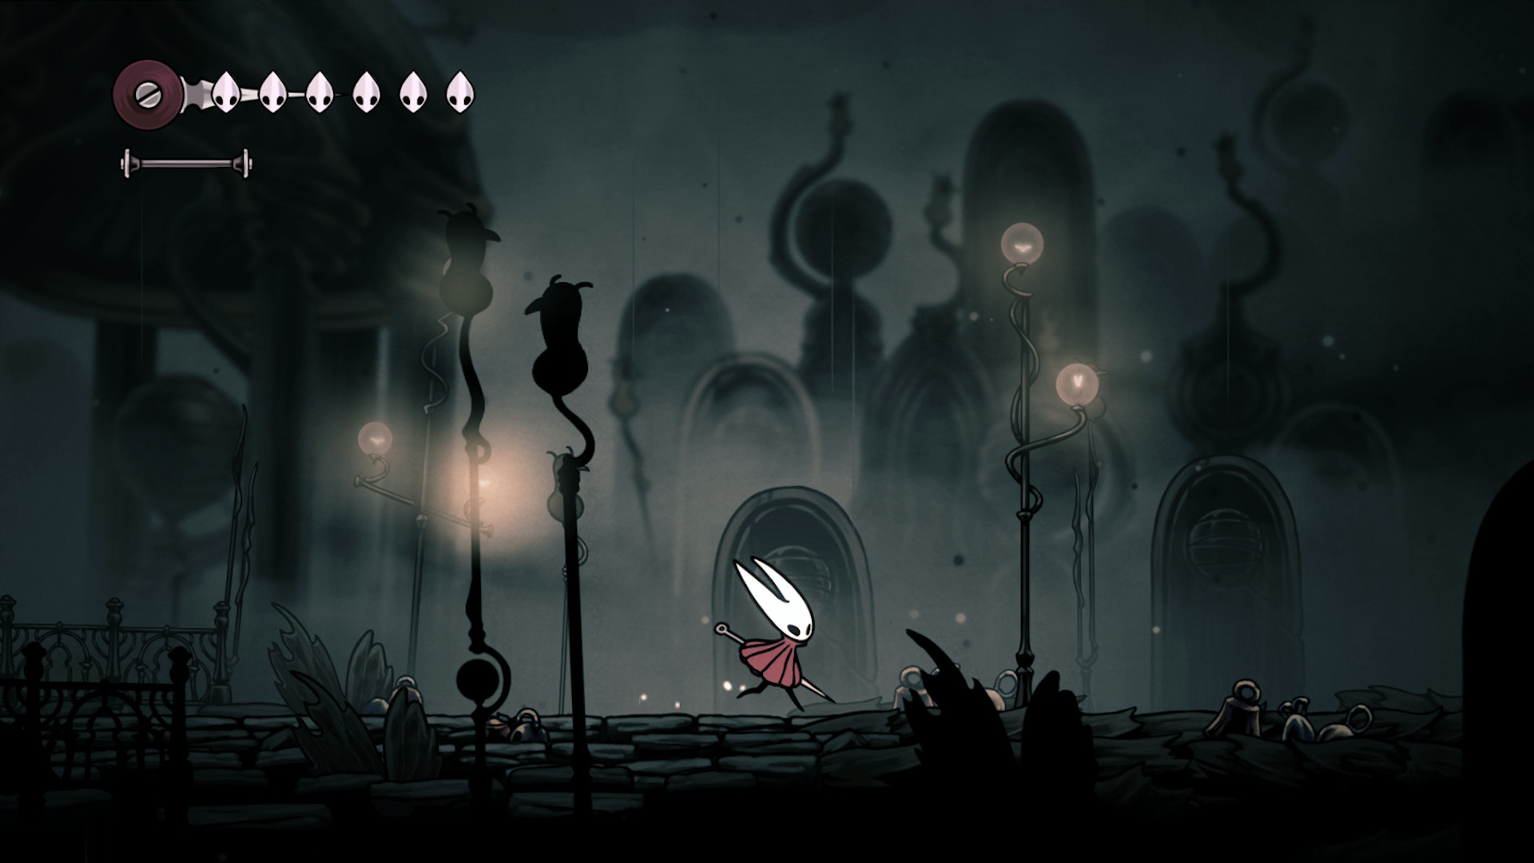
Concept|Research|Mood

Slide 3
Target
People that are interested in fortune telling and wish to experience mystical designed work.
Be curious about the unknown .
Age range probably be teenage or above.

Slide 4
Aim
Using P5js platform or Three Js platform to create a mystical atmosphere on a web page that contains interaction.
Develop motion graphic and effect to build up the sense of space.
Considering my first physical project which was a fortune telling made with LEDs and TFT display. I would like to go further on fortune telling features and build up more on the visuals. To do project on web tech could let me explore on how the system start and end which eye-catching visuals. (ex. Motion graphic) With developing the visuals for my interaction, aim to create a fortune telling game with storyline.
Digital game system could allow more people to try on before it could go public.

Slide 5
Time line (planning)
Test out environment on both P5 js and Three js (try to find out the best visual environment for the outcome), or other platform
Adding/ perfecting motion graphics for opening/ ending scene
Week 2 - 4
Week 5 - 6
Week 1
15/06
Building actual game function (the fortune telling)
Adding storyline into the interaction

Slide 6

Concept
Black and White tone
Beginning animation
Motion graphic
Mystical environment

Slide 7
Design Document
For next week, please draft a basic design document. It should include:
A working title
Description of the experience (you should have this from this week already. Expand on it if need be.)
What's the Goal? It can be as simple as an exploration.
Basic Elements
Annotated List of Design Values
Interfaces and Controls
UX Flow
Level Design
Art Direction
Technical Overview
We will review these as a group.

